Slide 1
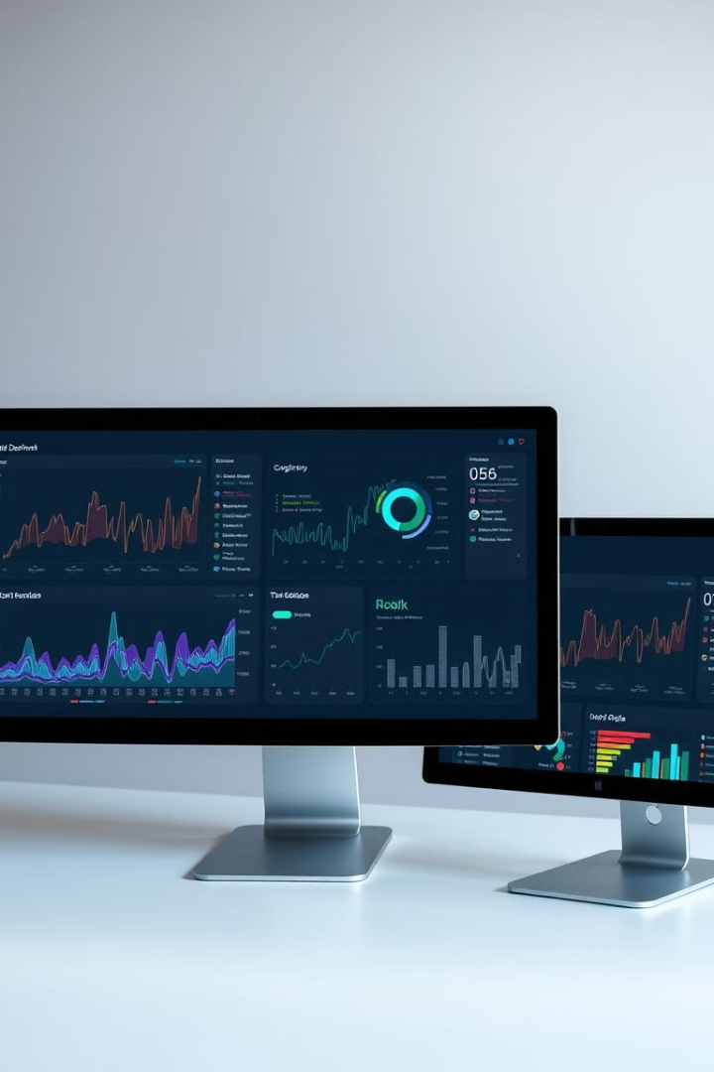

Northwind Traders
Welcome to our dashboard deep dive. Today, we'll explore key insights and statements from our Sales, Product, and Employee performance dashboards.
by Santhosh Kumar

Slide 2
Sales Performance Dashboard
Revenue
Customer Acquisition
Sales Conversion
Total revenue, growth rate, and year-over-year comparisons
New customer acquisition, customer churn rate, and customer lifetime value
Conversion rates, lead-to-sale ratios, and average deal size

Slide 3
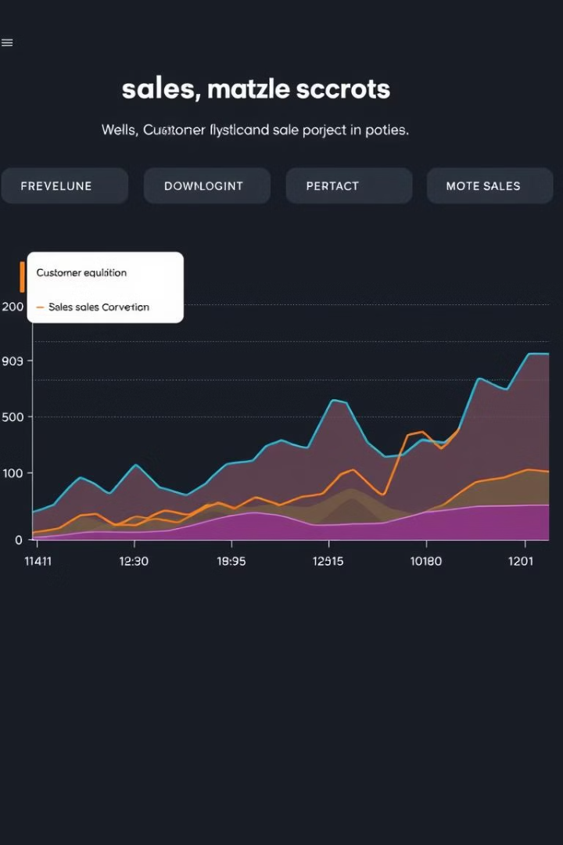
Sales Performance Insights
1
Sales Growth​
✅ Total sales increased by 111.95% between 2013 and 2015.​
✅ Sales rose by 244,454.08 in two years.​
✅ The steepest sales increase was from 218,363.84 to 462,817.92 between 2013 and 2015.​
​
2
Quarterly Performance
✅ Q1 had the highest Count of Quarter at 274, 58.38% higher than Q3. ✅ Q3 had the lowest Count of Quarter at 173 due to seasonal factors. ✅ Q1 accounted for 33.01% of the total Count of Quarter. ✅ Count of Quarter and Sum of Quarterly Sales are negatively correlated.
3
Strategy & Recommendations
✅ Focus on boosting lower-performing quarters (Q3) while maximizing Q1’s success. ✅ Implement seasonal promotions, inventory planning, and targeted sales efforts to stabilize sales.

Slide 4
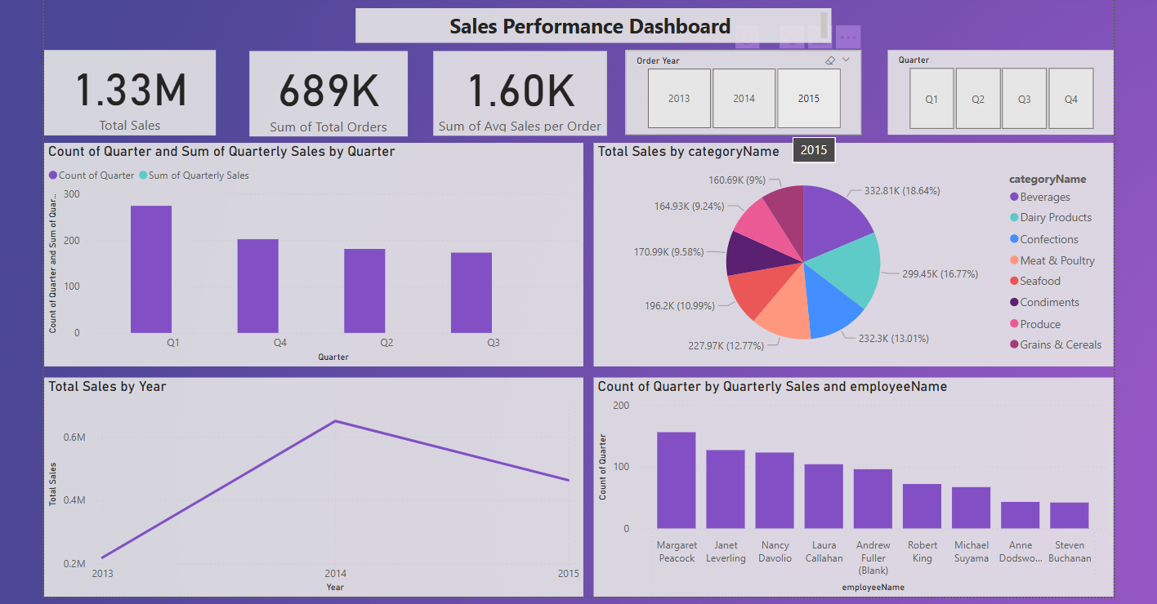

Slide 5
Product Performance Dashboard
Sales
Inventory
Pricing
Top-selling products, revenue per product, and sales growth rate
Stock levels, inventory turnover, and reorder points
Price changes, profit margins, and competitor pricing analysis

Slide 6
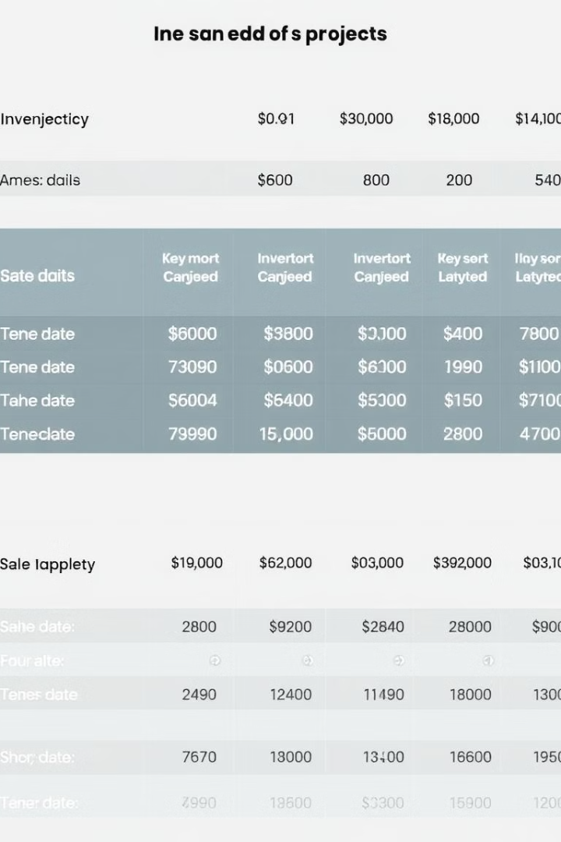
Product Performance insights & Trends
✅ November had the highest Total Sales at 19,313.92, which was 332.01% higher than July, the lowest-performing month at 4,470.68. ✅ Total Sales fluctuated between 4,470.68 and 19,313.92 across six months.
Best-Selling Product
✅ The largest gap between Total Sales and Count of productID occurred with Côte de Blaye, where Total Sales were 35,153.27 higher than Count of productID.
Strategy & Recommendations
✅ Focus on boosting low-performing months (July) by optimizing promotions and inventory. ✅ Identify high-demand products like Côte de Blaye and ensure stock availability to maximize revenue.

Slide 7
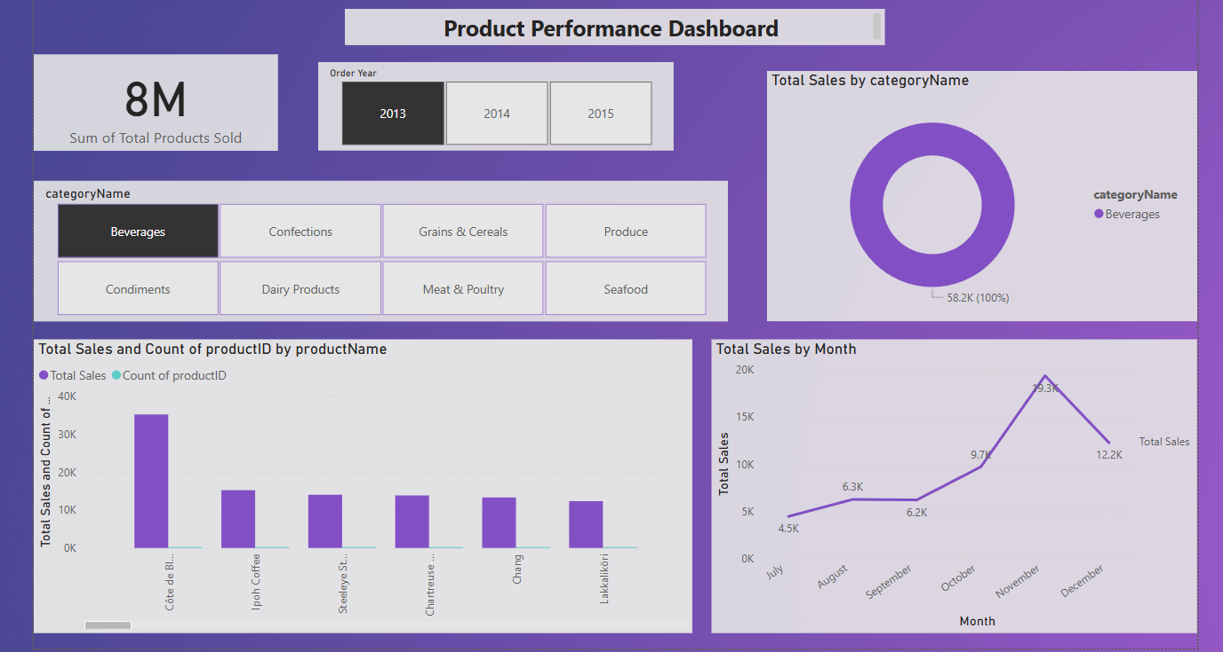

Slide 8
Employee Performance Dashboard
Productivity
Retention
Engagement
Individual employee performance, team output, and project completion rates
Employee turnover, absenteeism, and satisfaction levels
Employee feedback, survey results, and participation in training programs

Slide 9
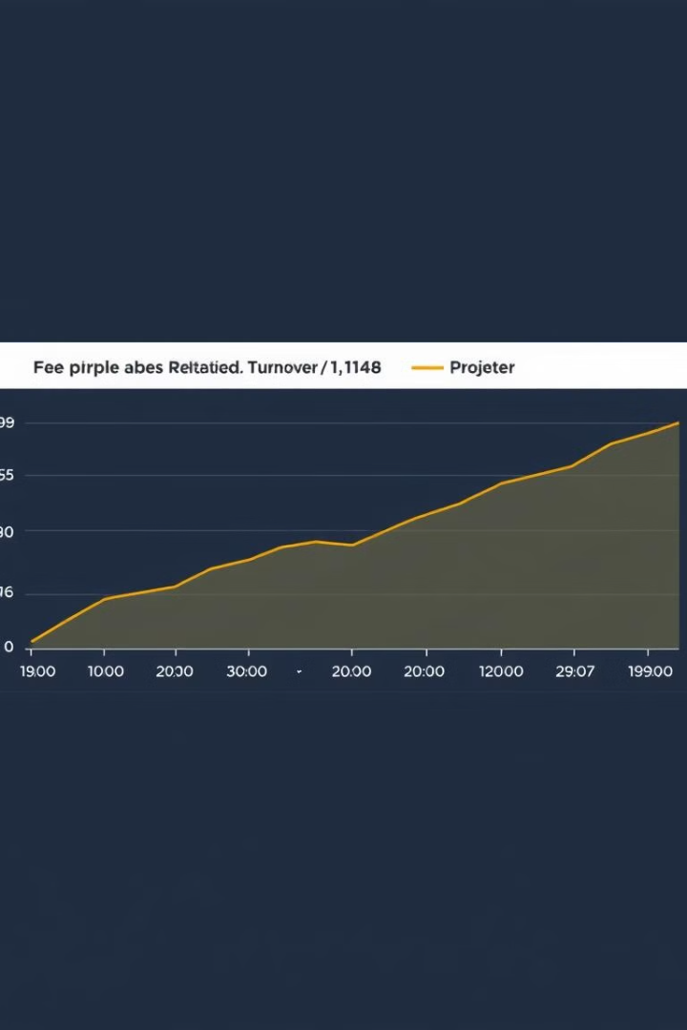



Employee Performance insights
Sales Trends & Fluctuations
✅ Total Sales decreased by 87.80% between October 1, 2014, and December 31, 2014. ✅ A 115.73% increase in Total Sales (+3,522.53) occurred between December 11, 2014, and December 31, 2014, reversing the downward trend. ✅ The steepest decline was between October 27, 2014, and December 10, 2014, with Total Sales dropping from 4,529.57 to 4,049.69.
Turnover
✅ Janet Leverling had the highest Total Sales at 36,909.63, which was 932.59% higher than Robert King, the lowest performer with 3,574.48. ✅ Total Sales ranged between 3,574.48 and 36,909.63 across all 9 employees. ✅ Janet Leverling contributed 21.68% of the total Count of OrderID.
Strategy & Recommendations
✅ Focus on identifying causes of sales declines and implementing strategies to sustain upward trends. ✅ Recognize top-performing employees (Janet Leverling) and apply their sales strategies to underperforming employees. ✅ Provide sales training & incentives to balance performance across the team.✅ Focus on identifying causes of sales declines and implementing strategies to sustain upward trends. ✅ Recognize top-performing employees (Janet Leverling) and apply their sales strategies to underperforming employees. ✅ Provide sales training & incentives to balance performance across the team.

Slide 10
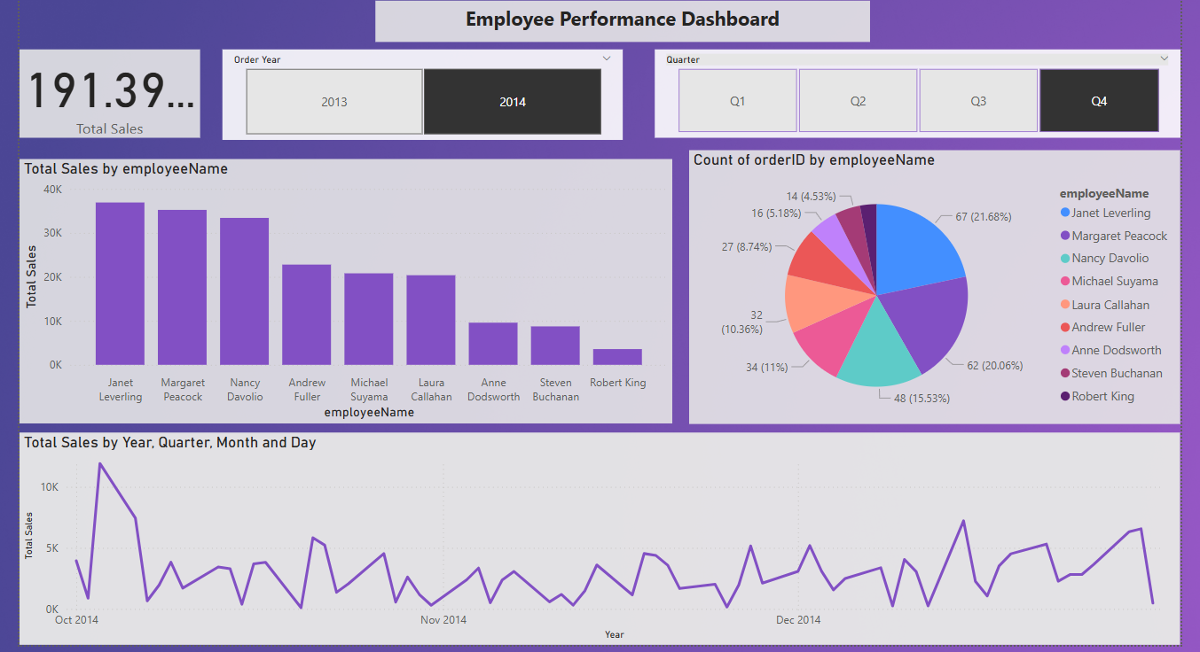

Slide 11
Dashboard Insights Summary
🔹 Sales Performance – Strong growth trend, key seasonal peaks, and correlations with quarterly performance.
🔹 Product Performance – Top-selling products identified, strong sales-product correlations, and month-wise trends.
🔹 Employee Performance – Best-performing employees, impact on sales, and performance fluctuations over time.
📌 Key Takeaways
✅ Data-driven decision-making for improved sales, product focus, and employee efficiency.
✅ Identifying trends to optimize future business strategies.
✅ Interactive dashboards enable real-time insights and better planning.
🚀 Thank You!
🔍 Making Better Business Decisions with Data!

